Slide 1
R Coding Practice: Chapter 2
Sun Li

Slide 2
CASE PROBLEM 1 PAGE 82 PAGE 70-71 PAGE 78-81
upload and summarize screenshots in powerpoint (graphs)
upload the code in github

Slide 3
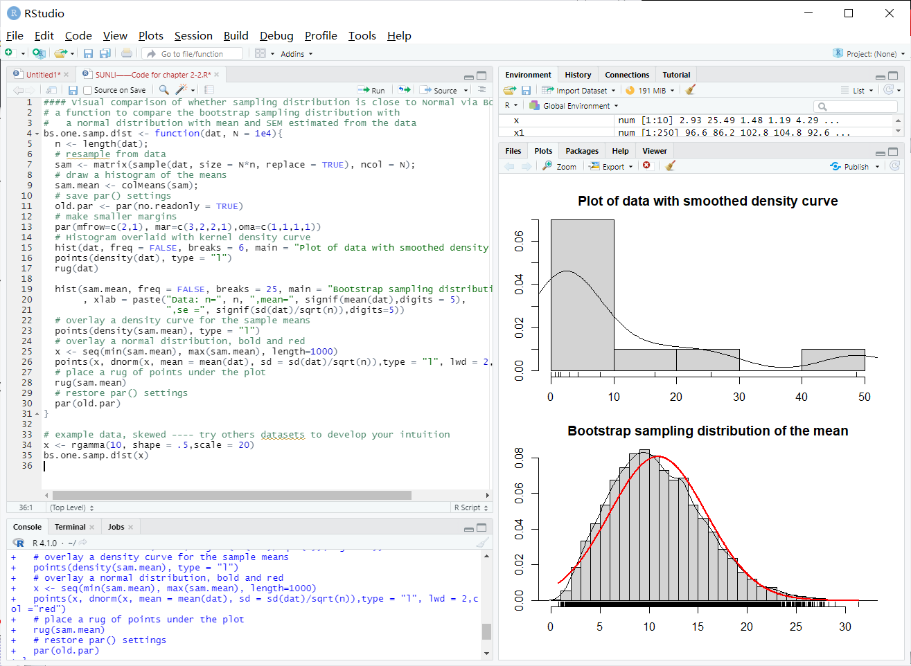

Slide 4
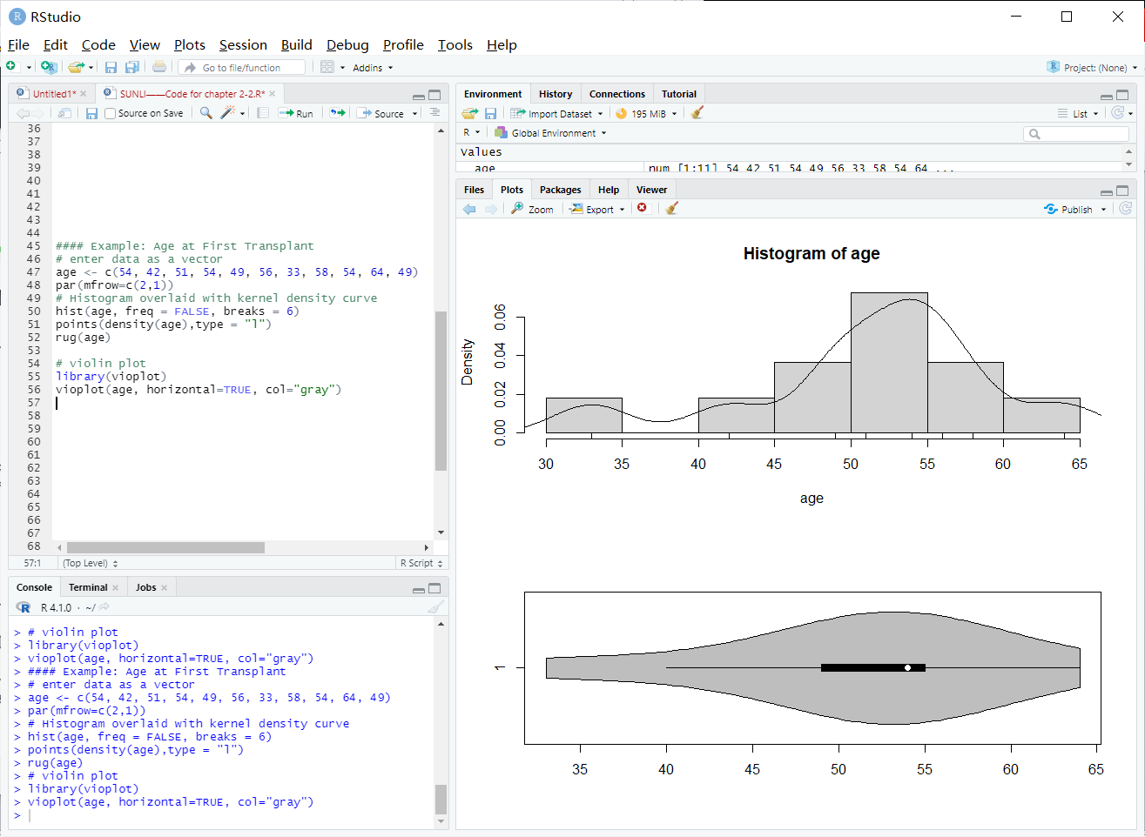

Slide 5
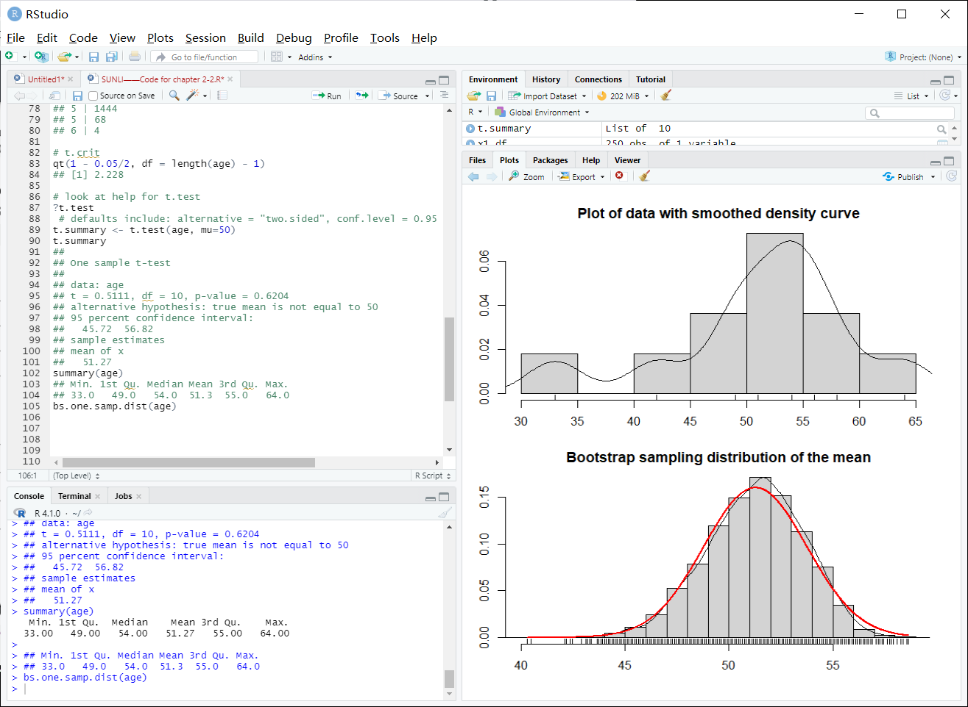

Slide 6
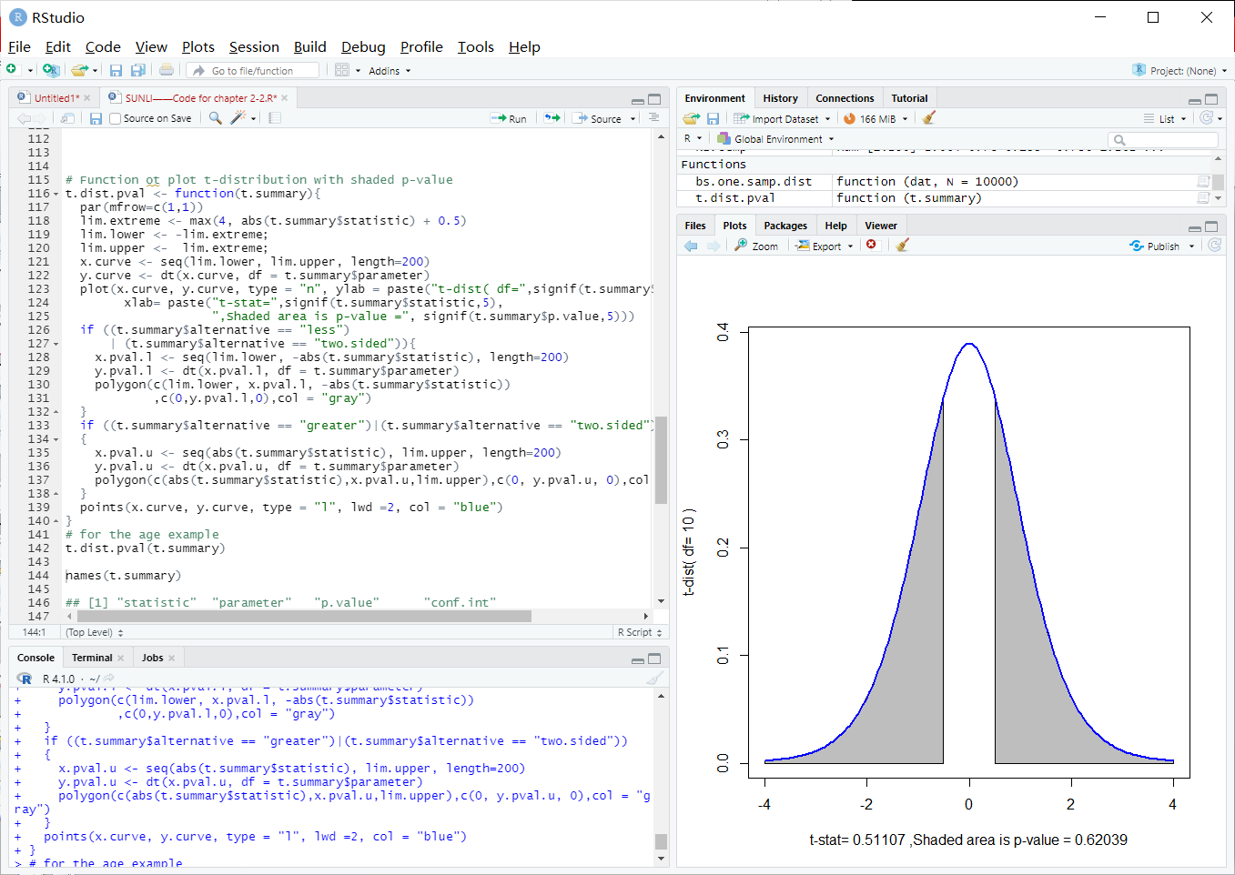

Slide 7
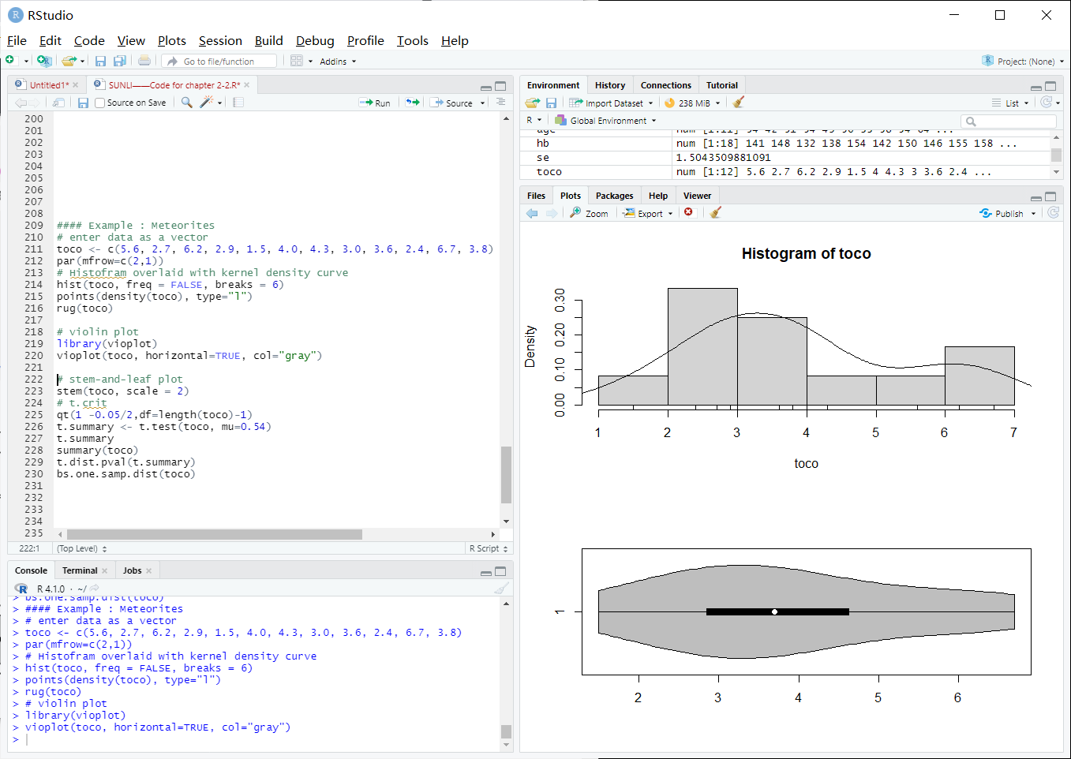

Slide 8
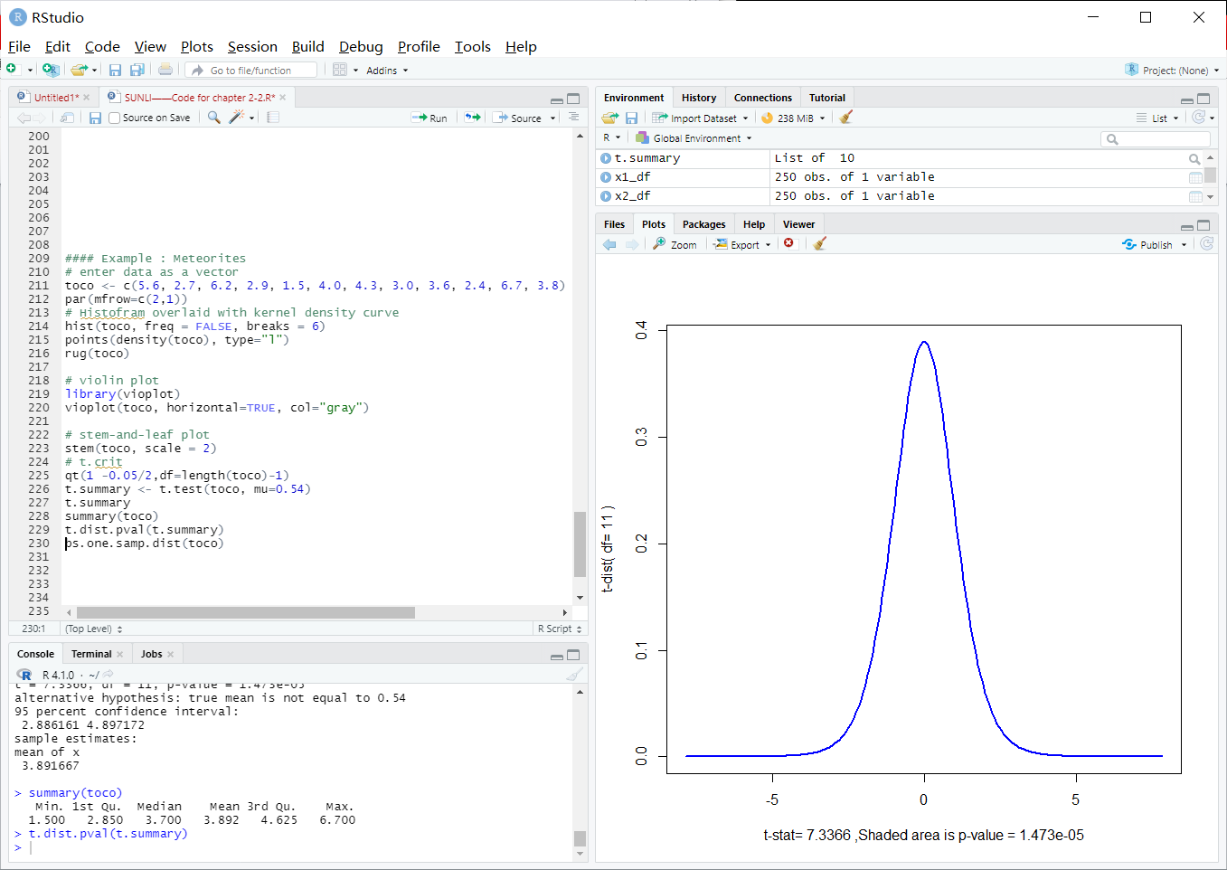

Slide 9
